Slide 1
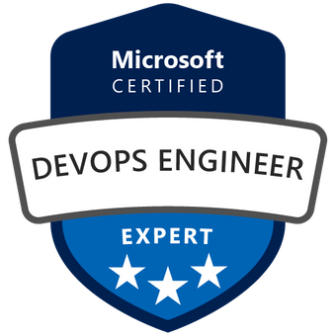
Exam AZ-400: Microsoft DevOps Solutions Crash Course
Tim Warner @TechTrainerTim

Slide 2
Session 2 of 2 Learning Goals
Sweep up yesterday's shavings
Author your own AzDo extensions
Integrate Azure Arc with Azure Pipelines
Lock down pipelines (code-signing tasks)
Containers & Azure Pipelines
Azure Infrastructure
Artifacts & Test Plans
Monitoring

Slide 3
Course Materials
timw.info/az400

Slide 4

Session Recordings

Slide 5

Tim's Certification Study Model

Slide 6

Thank you!
Course materials: timw.info/az400
Twitter: @TechTrainerTim
Work: timw.info/ps
Web: TechTrainerTim.com

Slide 7
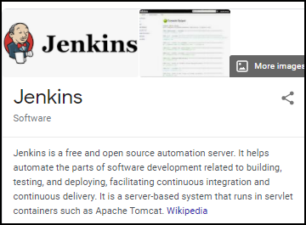
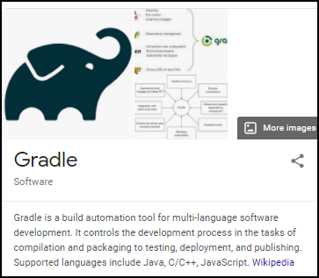
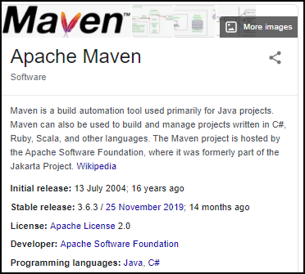
Build Engines

Slide 8
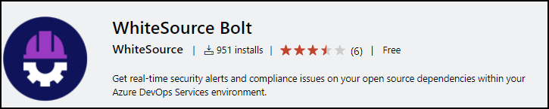
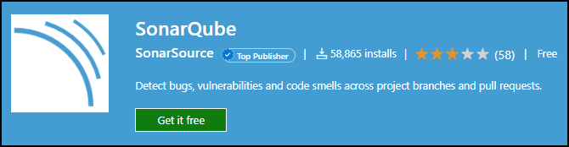
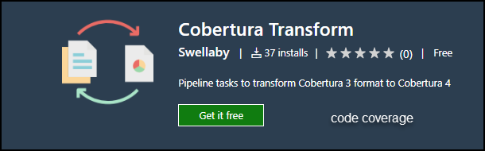
Code Testing Extensions

Slide 9
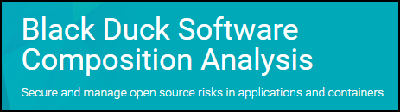
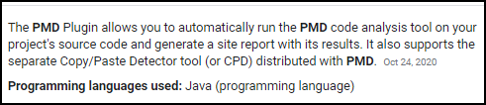
Code Testing Extensions, Continued

Slide 10
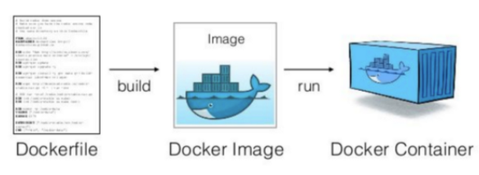
Docker Container Development Process

Slide 11
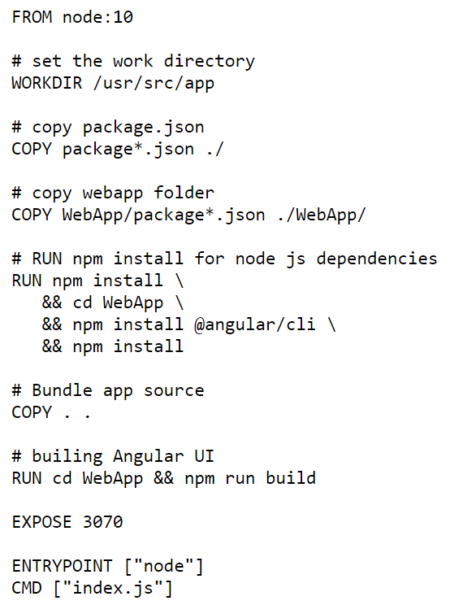
Single-Stage Dockerfile

Slide 12
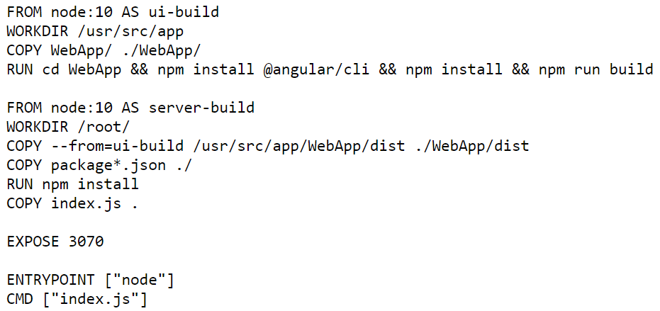
Multi-Stage Dockerfile

Slide 13
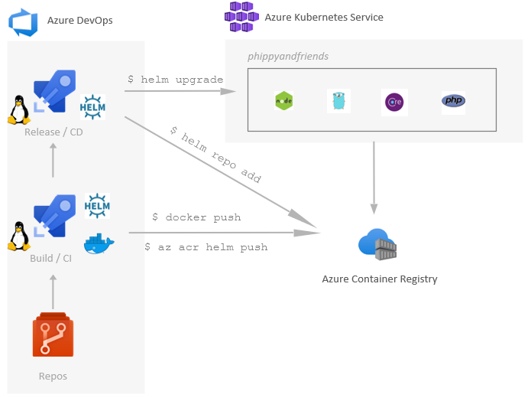
Helm, ACR, and AKS

Slide 14
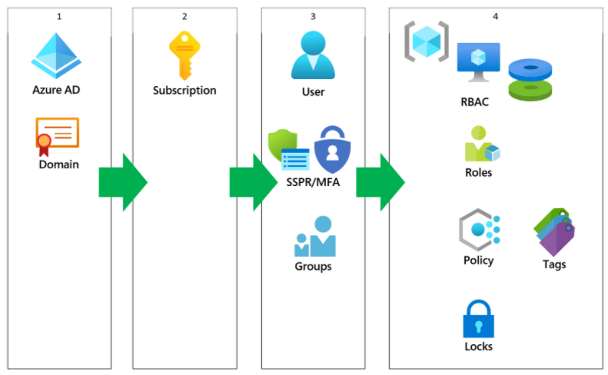
Azure AD Identity

Slide 15
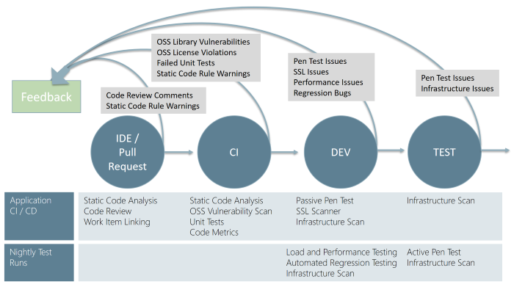
Continuous Security Validation

Slide 16
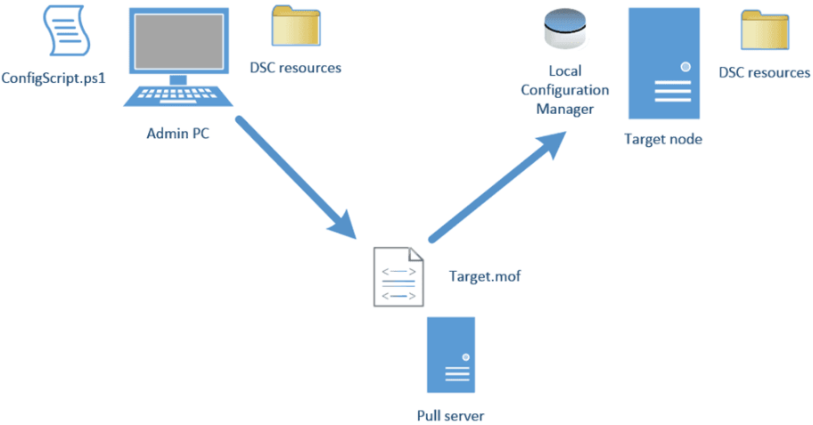
Azure Automation DSC

Slide 17
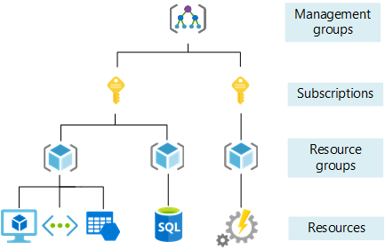
Azure Management Scopes

Slide 18
Dependency Management with Azure Artifacts

Slide 19
Elements of a Dependency Management Strategy
Standardization
Package formats and sources
Versioning

Slide 20
Identifying Dependencies
Find components and source code that can have independent:
Deployment
Release
Versioning
Things to consider:
Change frequency
Changes should be unrelated to other parts of system
Can package exist by itself
Package should add value for others

Slide 21



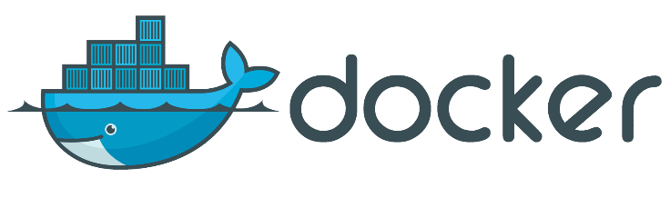
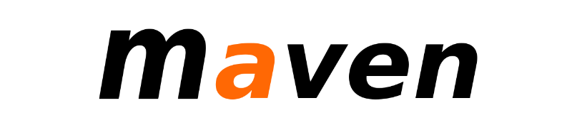
Packages
A package is a formalized way of creating a distributable unit of software artifacts that can be consumed from another software solution.
Microsoft platform and .NET artifacts
Node.js modules
Python scripts
Universal packages
Java packages
Docker images
NuGet Microsoft development platform and .NET artifacts
Npm node.js modules
Maven Java packages
Python Python script
Universal Set of related files
Docker Container images
Symbols Symbol files

Slide 22
Package feeds
Centralized storage of package artifacts:
Public or privately available
Offer secure access for private feeds
Versioned storage of packages
Managed by tooling
Also known as:
Package repositories
Package registry
Package Types:
Public: NuGet.org, Npmjs.org, PyPi.org, Docker Hub
Private: MyGet, Azure Container Registry, Azure Artifacts, Self-hosted solutions

Slide 23
Securing access to package feeds
Feeds have to be secured:
Private feeds
Not allow access by unauthorized users for publishing
Restricted access for consumption:
Whenever a package feed and its packages should only be consumed by a certain audience, it is required to restrict access to it. Only those allowed access will be able to consume the packages from the feed.
Restricted access for publishing:
Secure access is required to restrict who can publish, so feeds and their packages cannot be modified by unauthorized or untrusted persons and accounts.

Slide 24
Exam AZ-400 Exam Strategy

Slide 25
Preparing for Online Testing

Slide 26
Tim's Online Testing Video
timw.info/online

Slide 27

Why Microsoft Online Testing?
COVID means Pearson VUE physical testing centers are unavailable
The Pearson OnVUE client has come a LONG way
I'll use online testing exclusively from now on

Slide 28
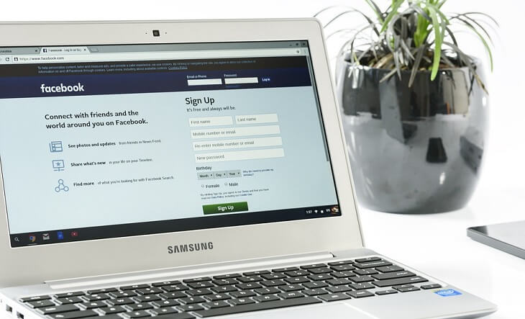
Pearson OnVUE System Requirements
Windows 10 / Windows 8.1
macOS High Sierra (10.13)
4 GB RAM
1024x768/16 resolution
1920x1080/32 recommended
Touchscreens are prohibited

Slide 29

Pearson OnVUE System Requirements
3 Mbps down/up network bandwidth
Mobile hotspot tethering is prohibited
Browsers:
IE 11, Edge, Chrome, Firefox, or Safari (latest versions)

Slide 30

Pearson OnVUE System Requirements
Webcam: 640x480/10 fps
Microphone: integrated
Headsets not allowed
Corporate VPNs, firewalls, and proxies will likely disrupt the delivery
Check with networking team first

Slide 31
Your Pre-Exam Checklist
Computer set up
Kill all tasks except for your browser
May need to use Task Manager or Activity Monitor
Additional monitors turned off
Mobile phone
ID

Slide 32
During the Exam
Keep your face in the webcam frame
Keep your hands away from your mouth
Ensure you aren't interrupted
Walled room
Door closed
No bio breaks are allowed

Slide 33
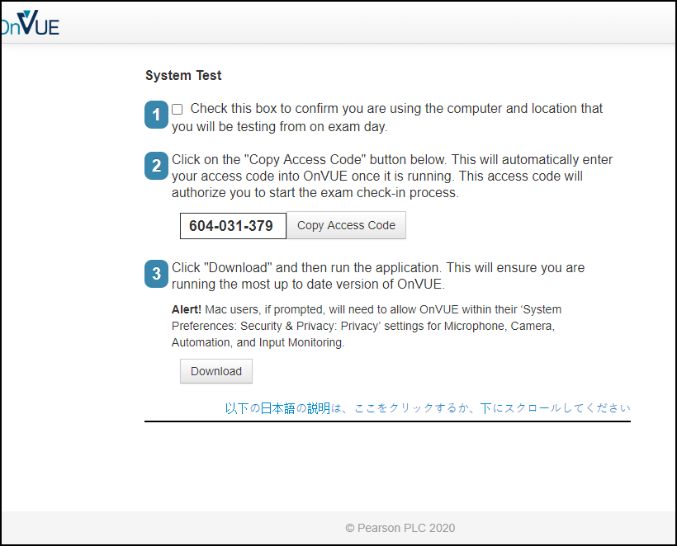

Slide 34
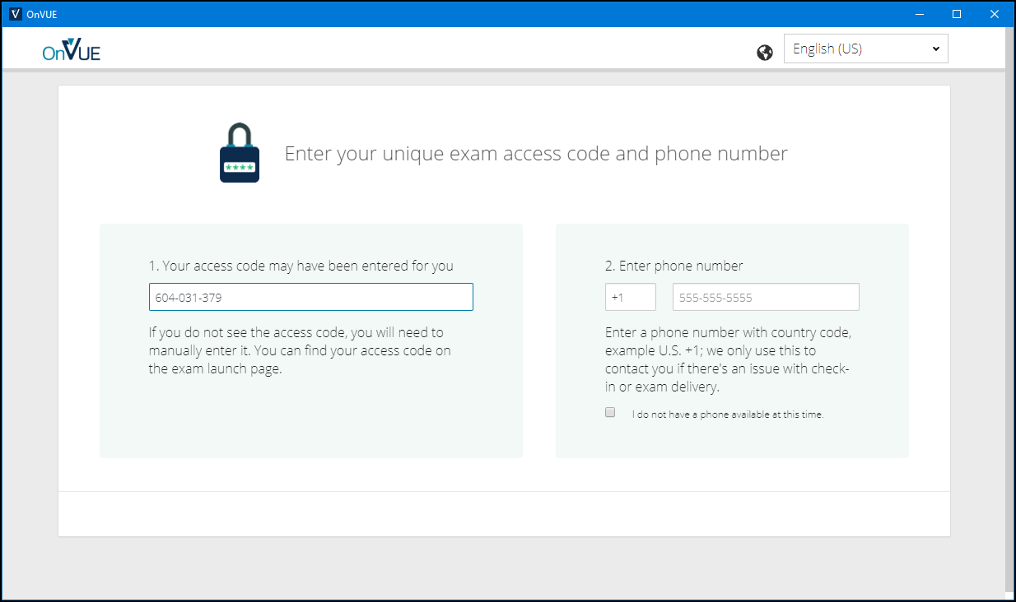

Slide 35
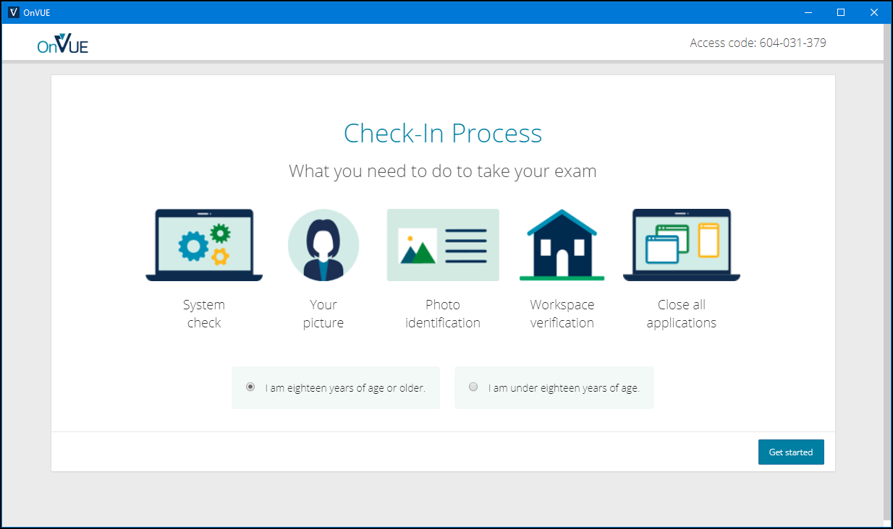

Slide 36
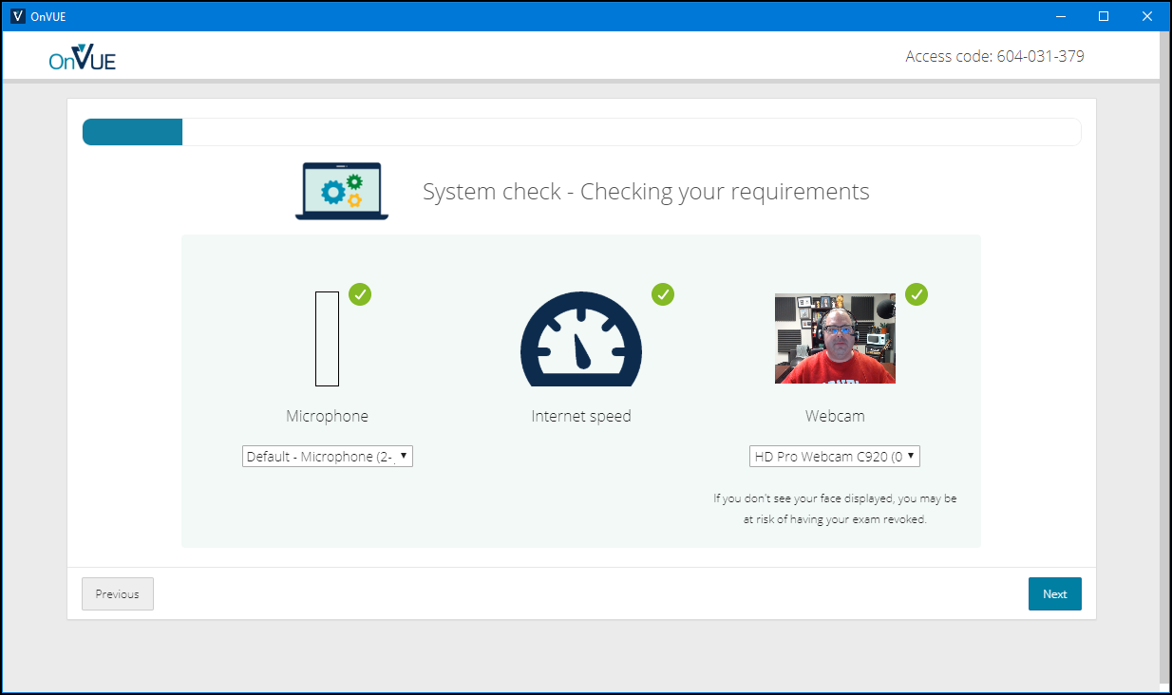

Slide 37
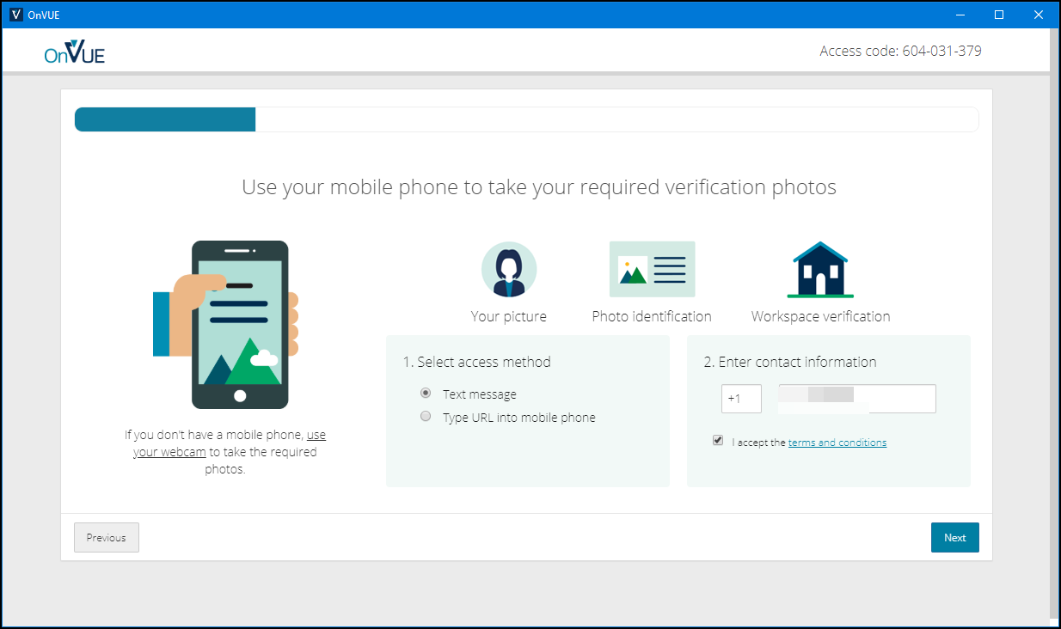

Slide 38
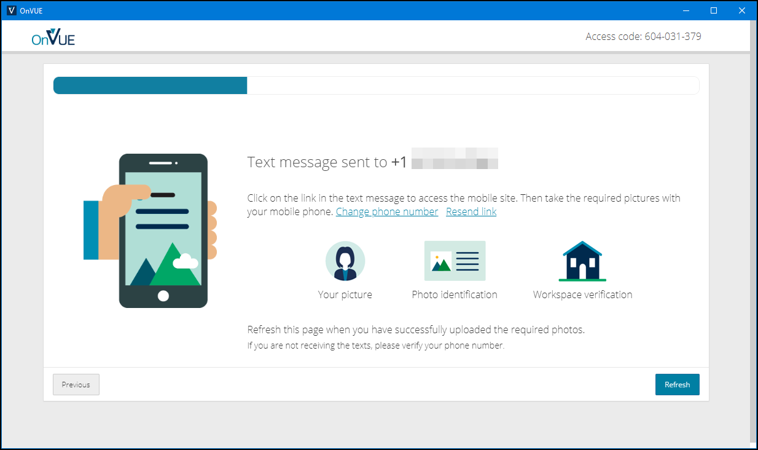

Slide 39
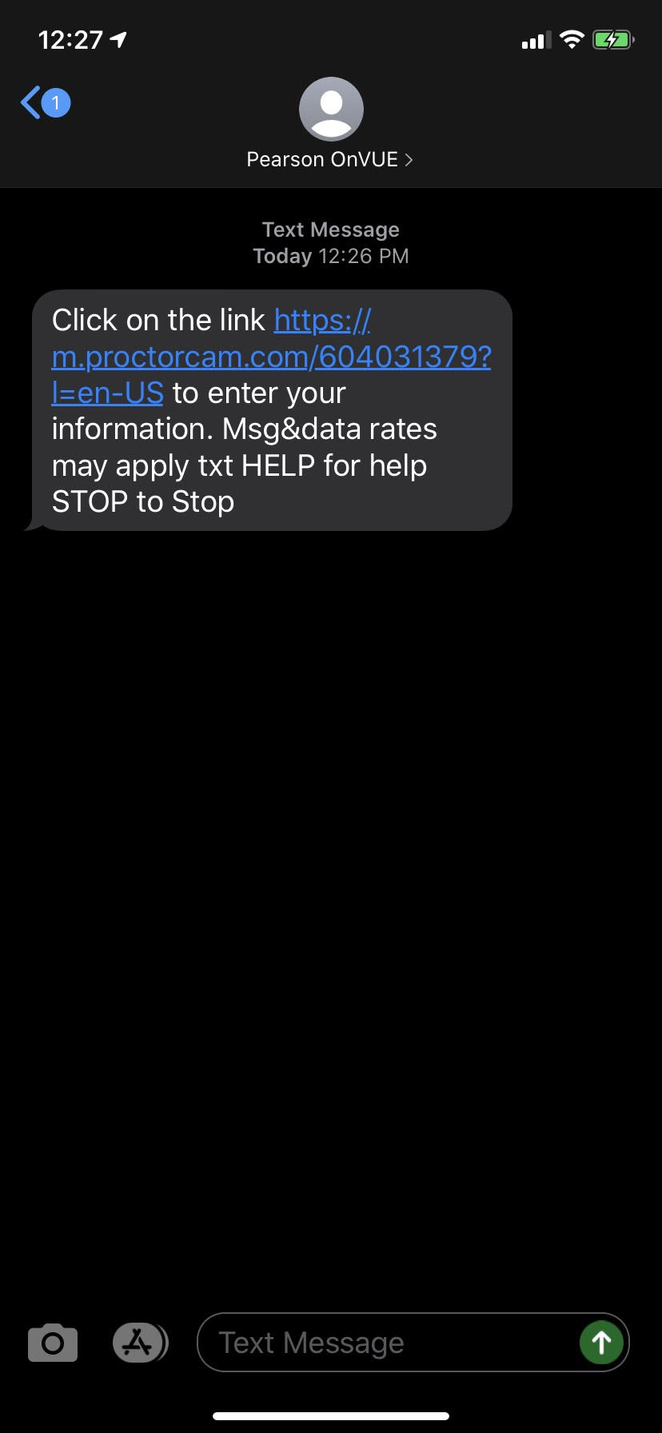
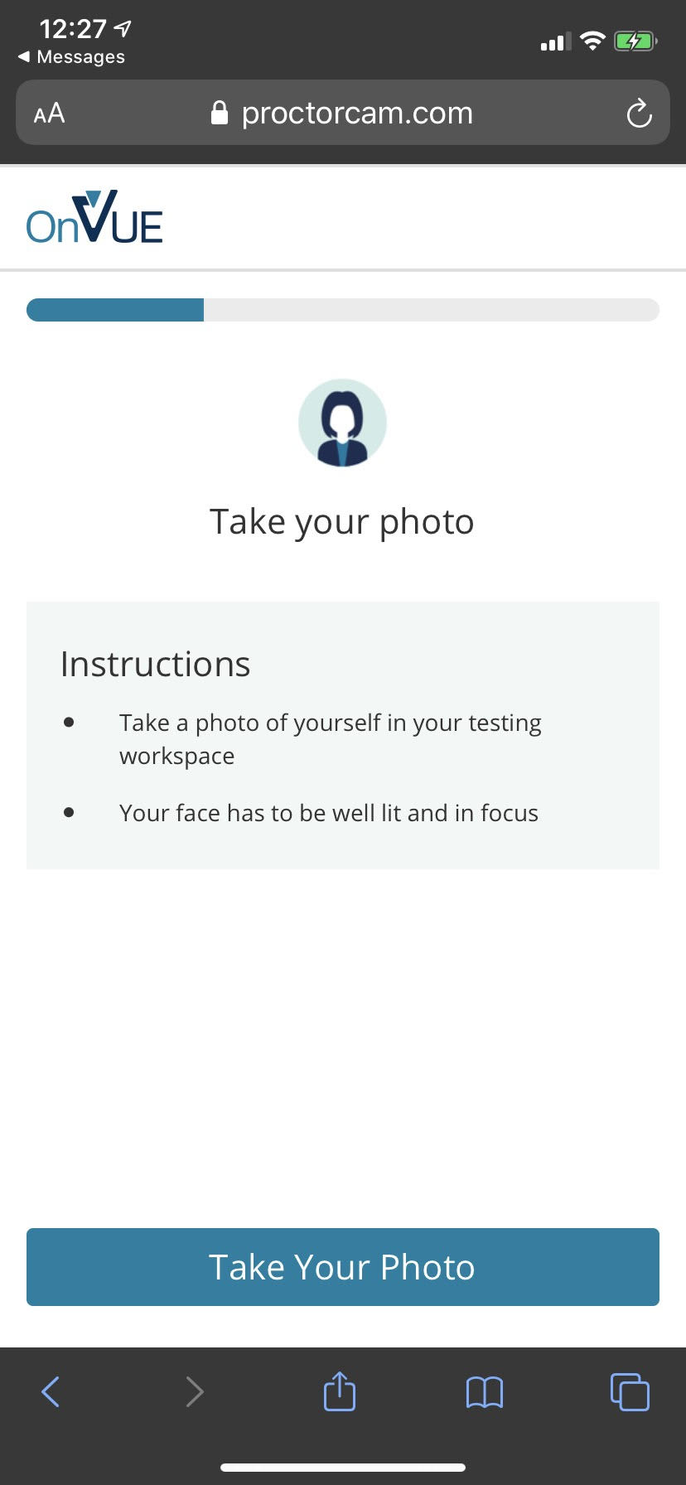
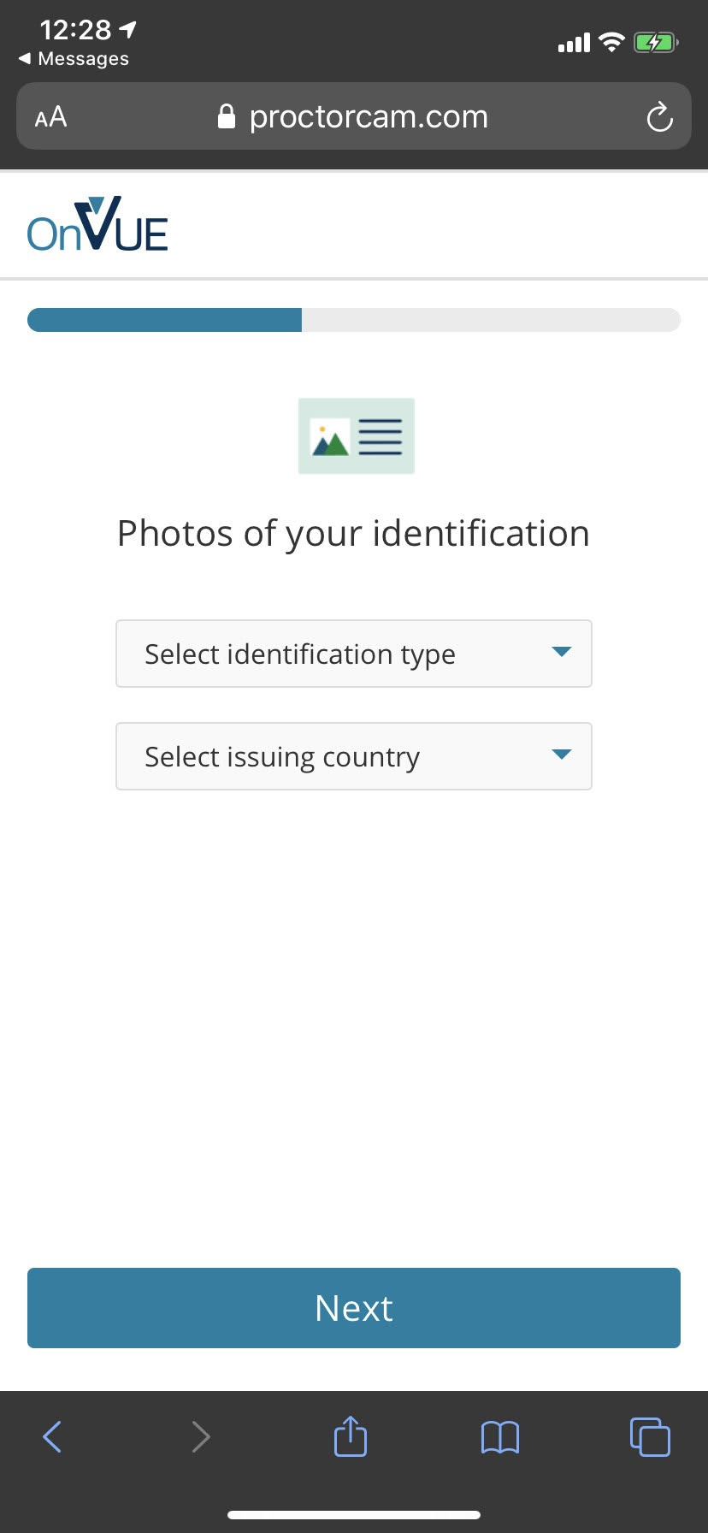

Slide 40
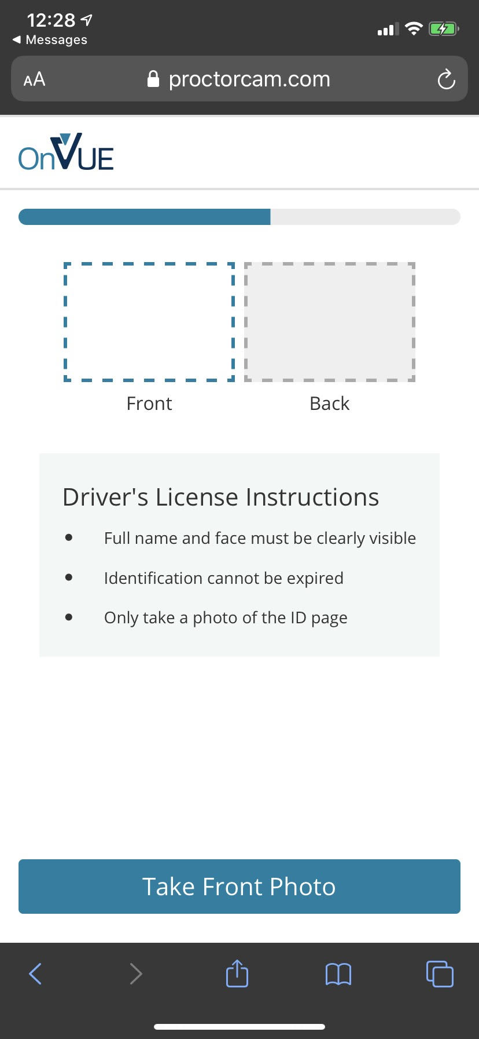
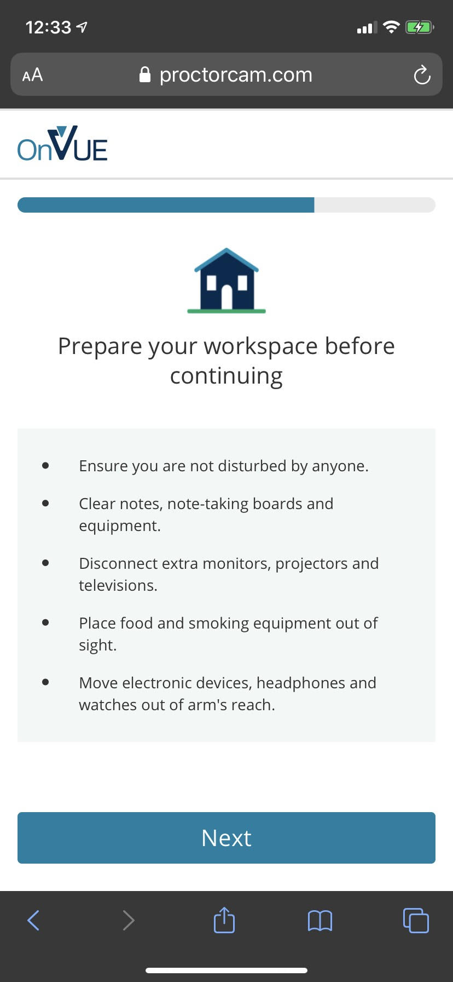

Slide 41
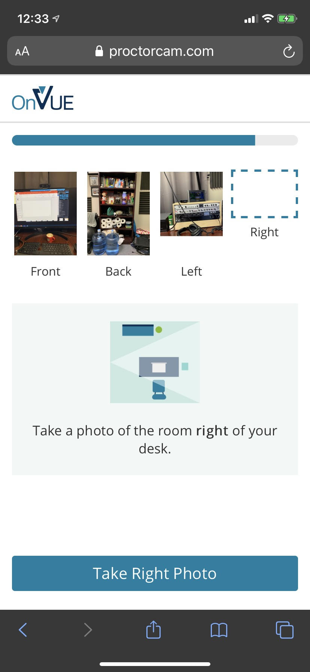
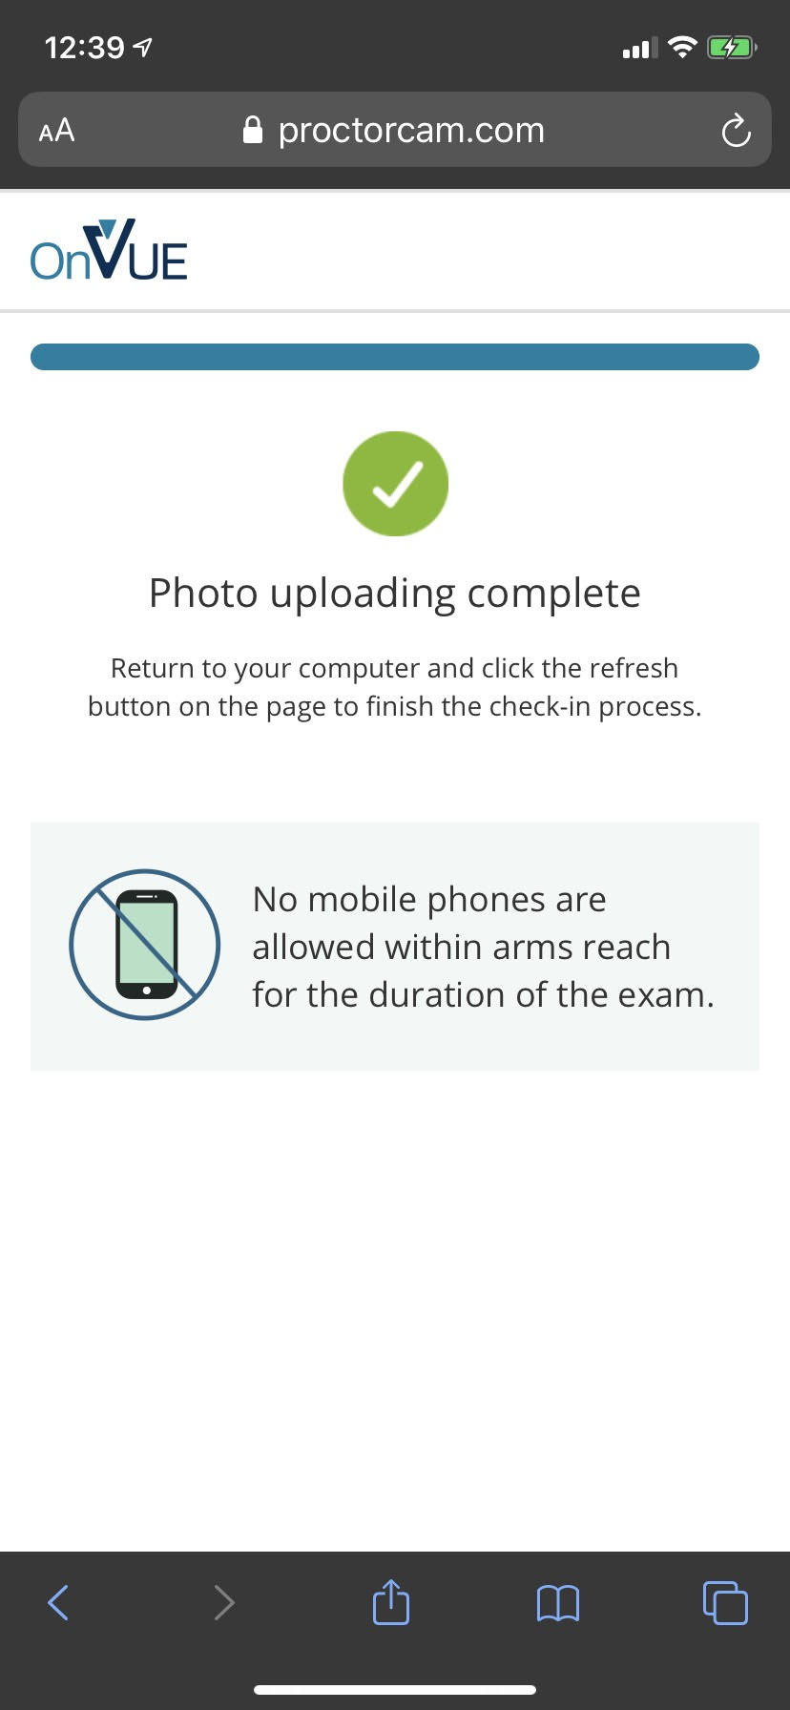

Slide 42
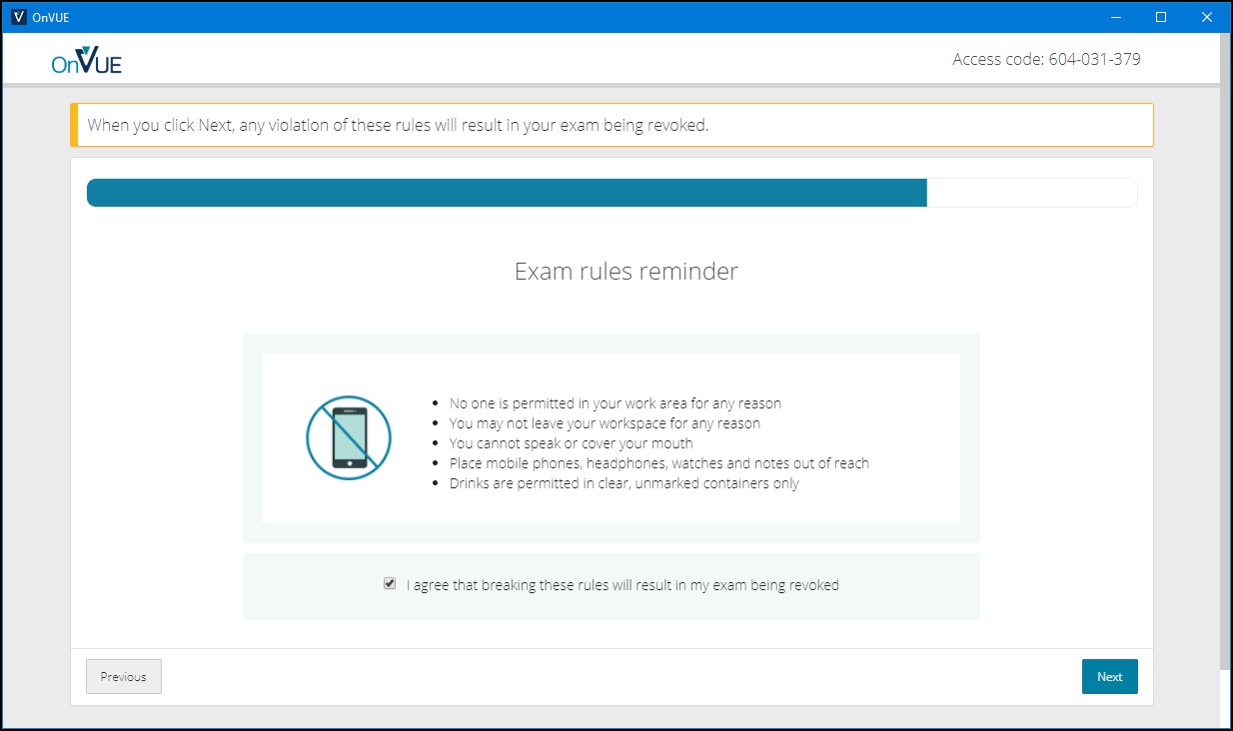

Slide 43
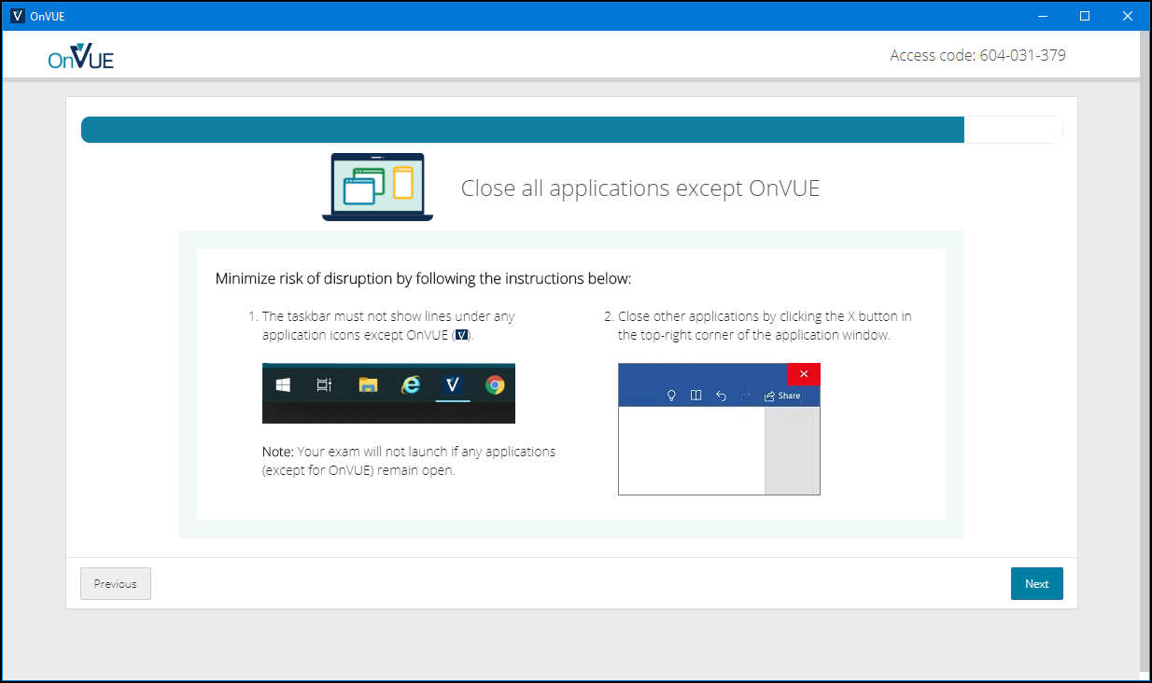

Slide 44
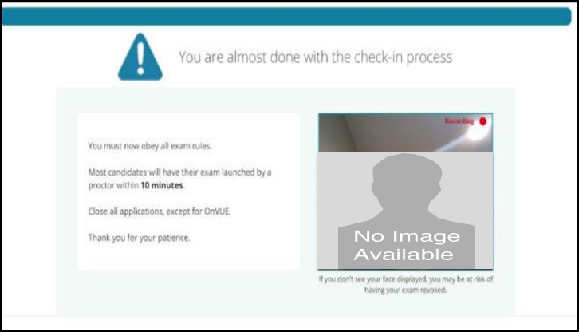

Slide 45
AZ-400 Exam Tips
Expect to see a lot of JSON, PowerShell, and Azure CLI
Expect NOT to see C# or JavaScript
It doesn't matter which exam order you use:
AZ-203
AZ-103/AZ-104
AZ-400
Perform due diligence in validating your environment for Microsoft online testing

Slide 46
AZ-400 Item Types

Slide 47

Single Answer Multiple Choice

Slide 48
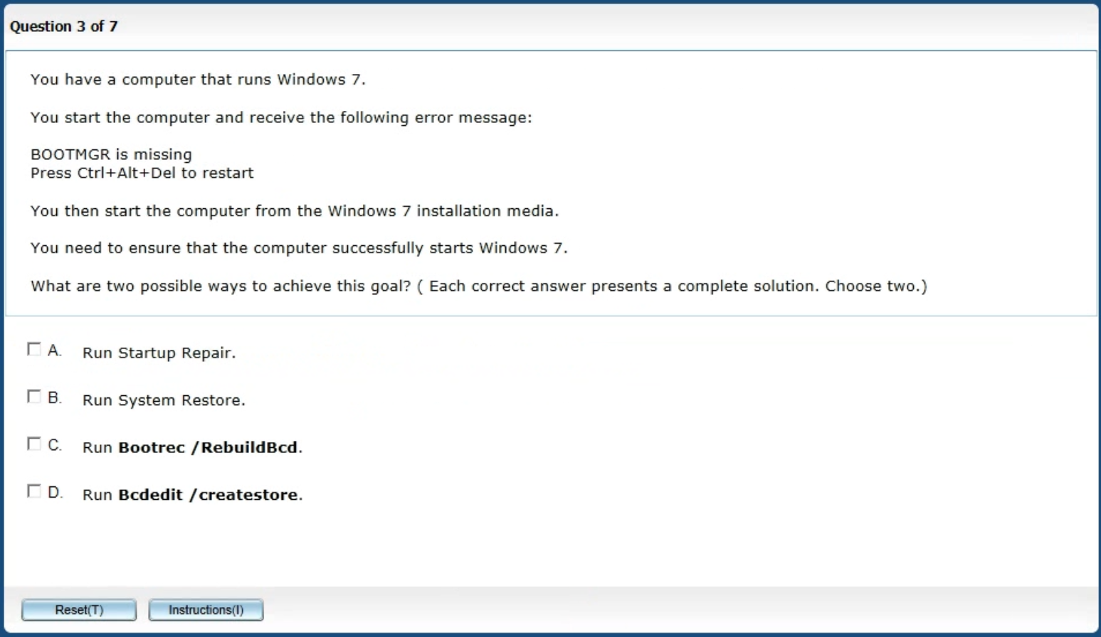
Multiple Answer Multiple Choice

Slide 49
Repeated Scenario
You need to move an Azure VM to another hardware host.
Solution: You redeploy the VM.
Does this solution meet the goal?
Yes
No

Slide 50
Repeated Scenario
You need to move an Azure VM to another hardware host.
Solution: You restart the VM.
Does this solution meet the goal?
Yes
No

Slide 51

Select and Place

Slide 52

Build List and Reorder

Slide 53

Active Screen/Fill in the Blank

Slide 54

Case Study

Slide 55






Performance-Based Lab

